Slide 1

Optimal Canola Crush & Lentils Locations
Utilizing Clustering Crop Yield Analysis - RM Level
IMRAN AFSAR
Cohort 6 – June 2024

Slide 2
Data Collection & Preprocessing
Saskatchewan Crops Yield Data
Crop Yield from 2008-2023
Geographical Boundaries of RMs in Saskatchewan
Subset of RMs – Mostly Southern Half of Province
2 Crop – Canola & Lentils
Converting Lentils Data from Pounds to Bushels
Data Conversion for Comparison e.g RM Numbers

Slide 3
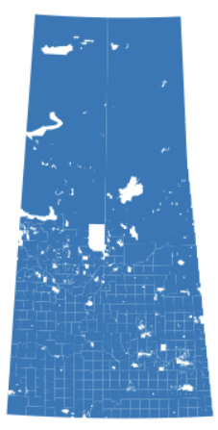
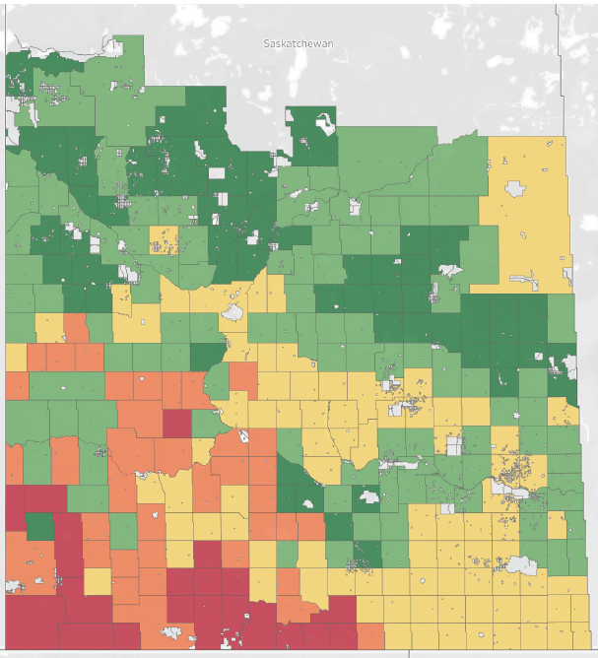
Geographical Boundaries of RMs in Saskatchewan

Slide 4
EXPLORATORY DATA ANALYSIS

Slide 5
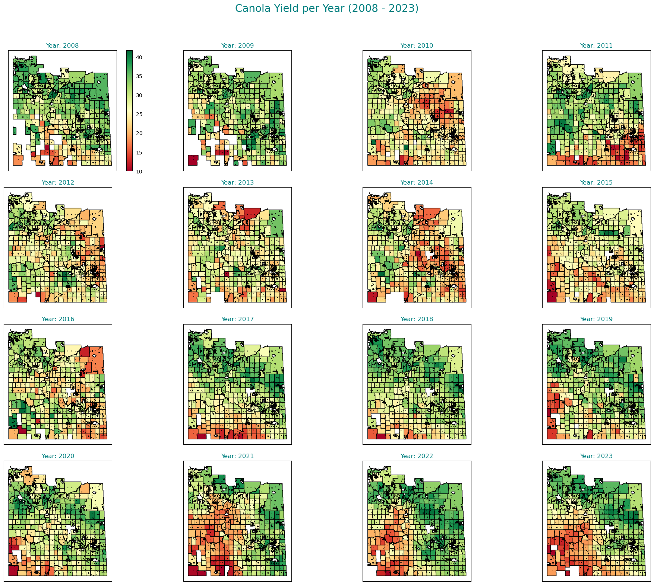
Canola Yield Per Year (2008 - 2023)

Slide 6
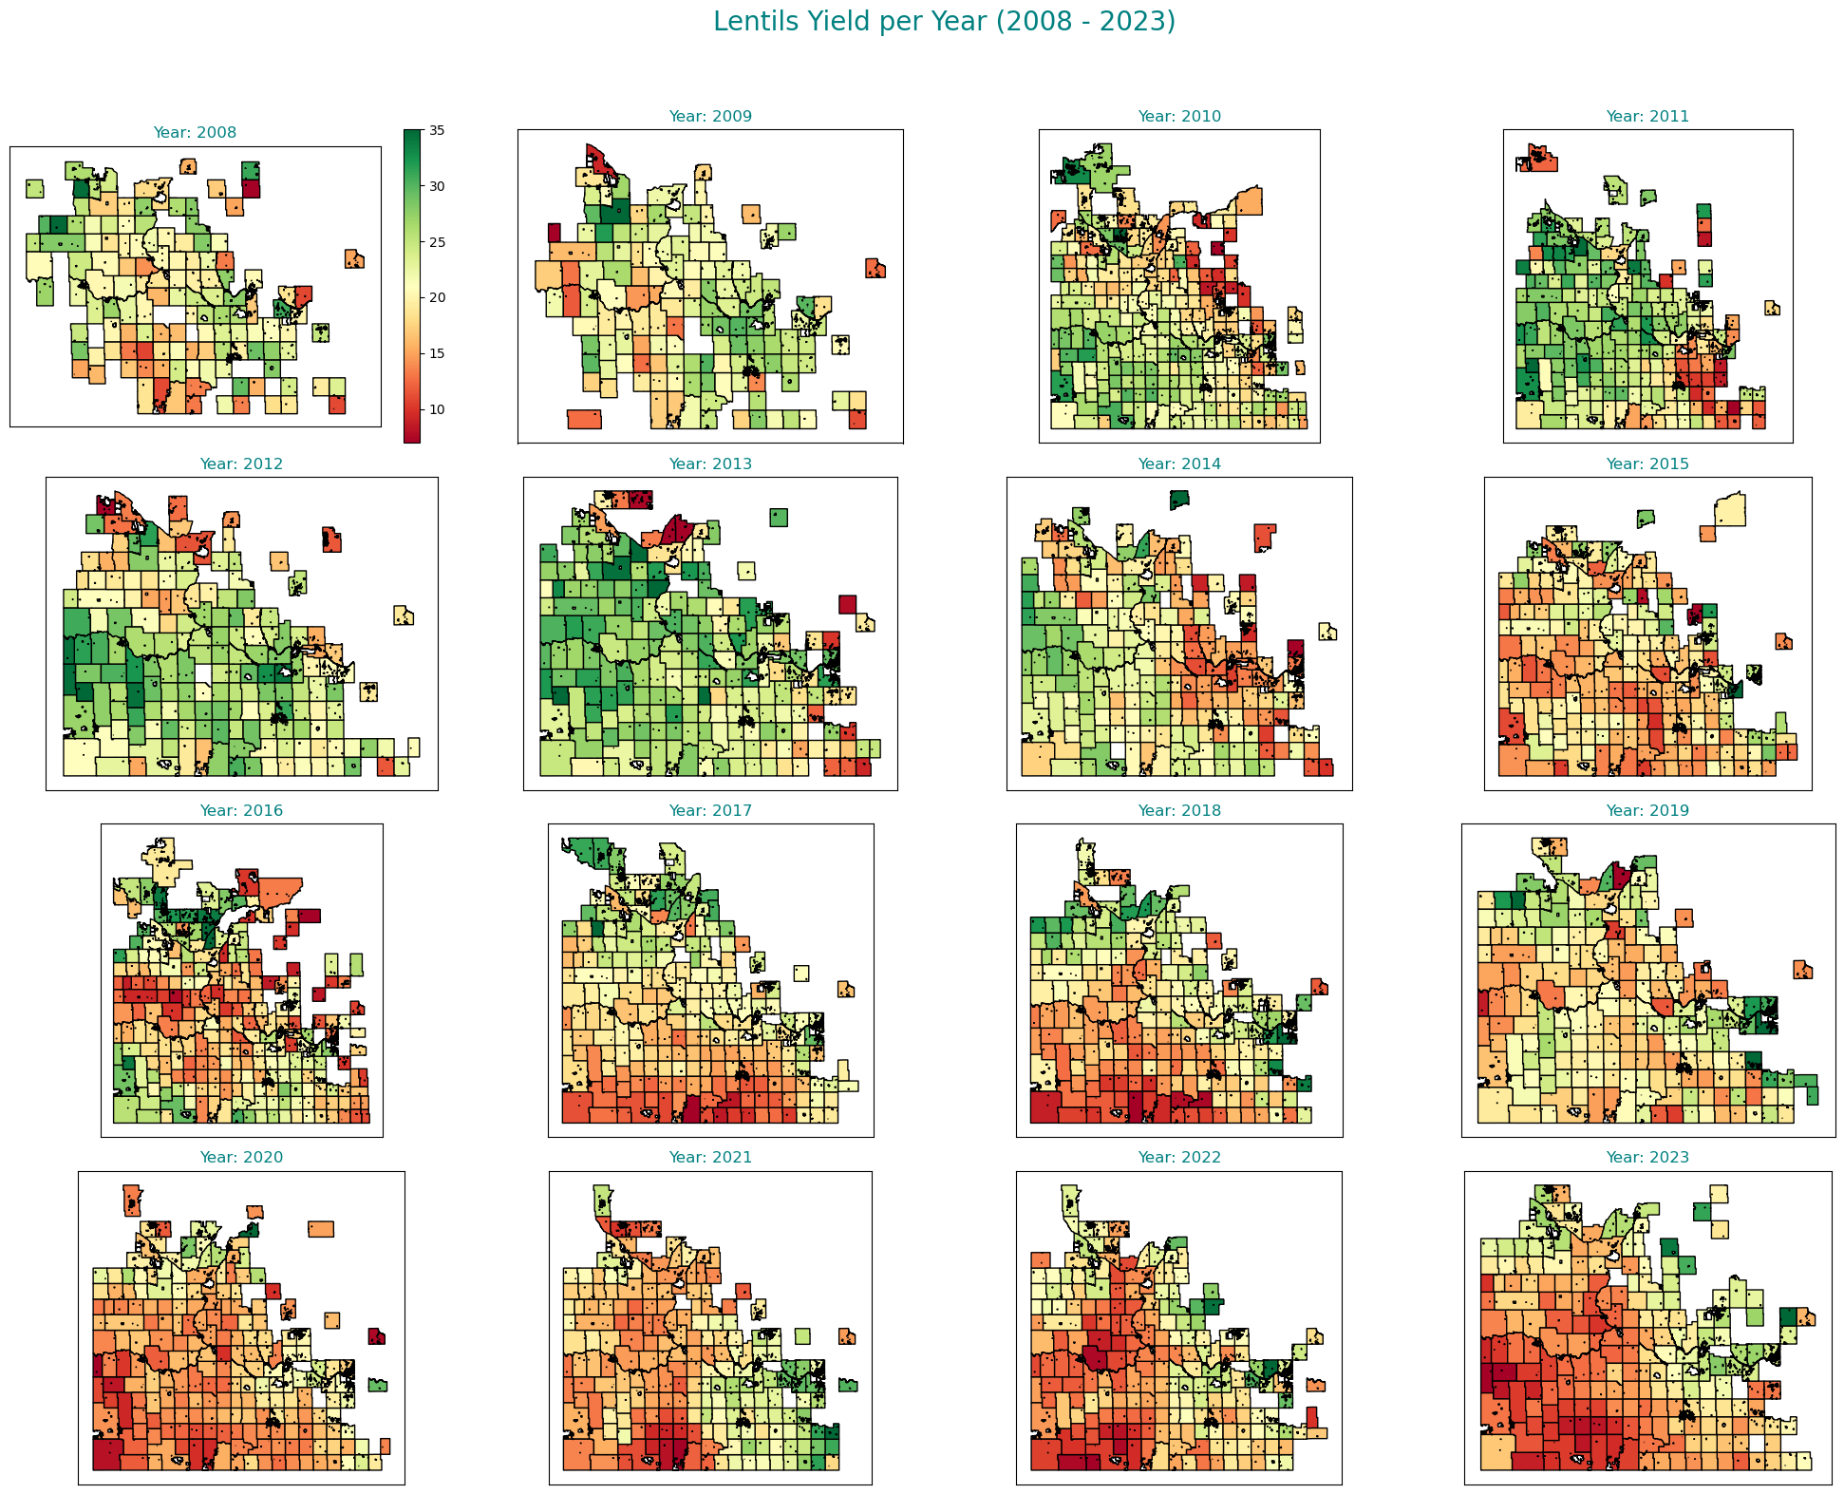
Lentils Yield Per Year (2008 - 2023)

Slide 7
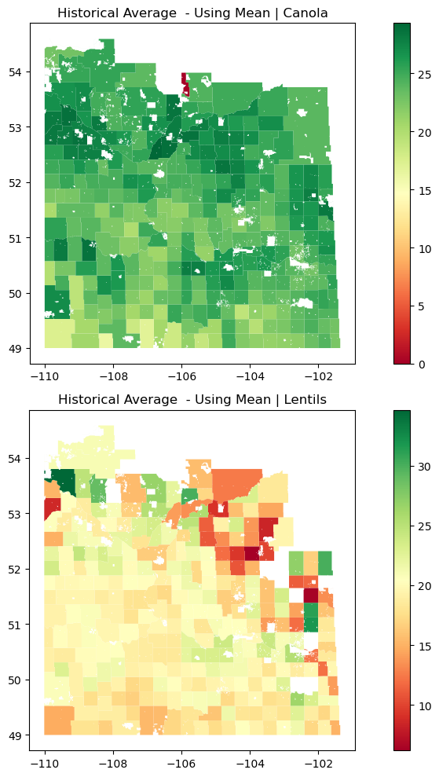
Historical Average of Canola & Lentils Using Mean

Slide 8
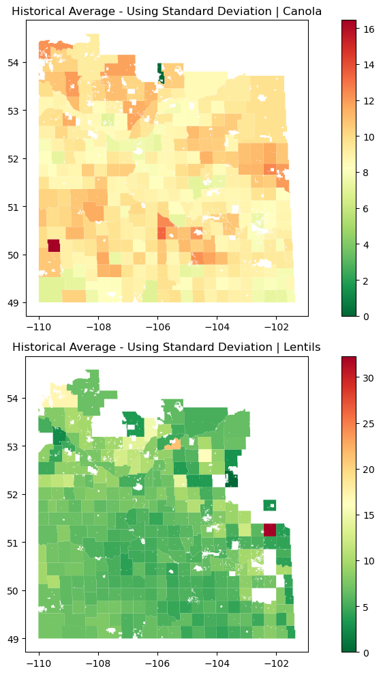
Historical Average of Canola & Lentils Using STD

Slide 9
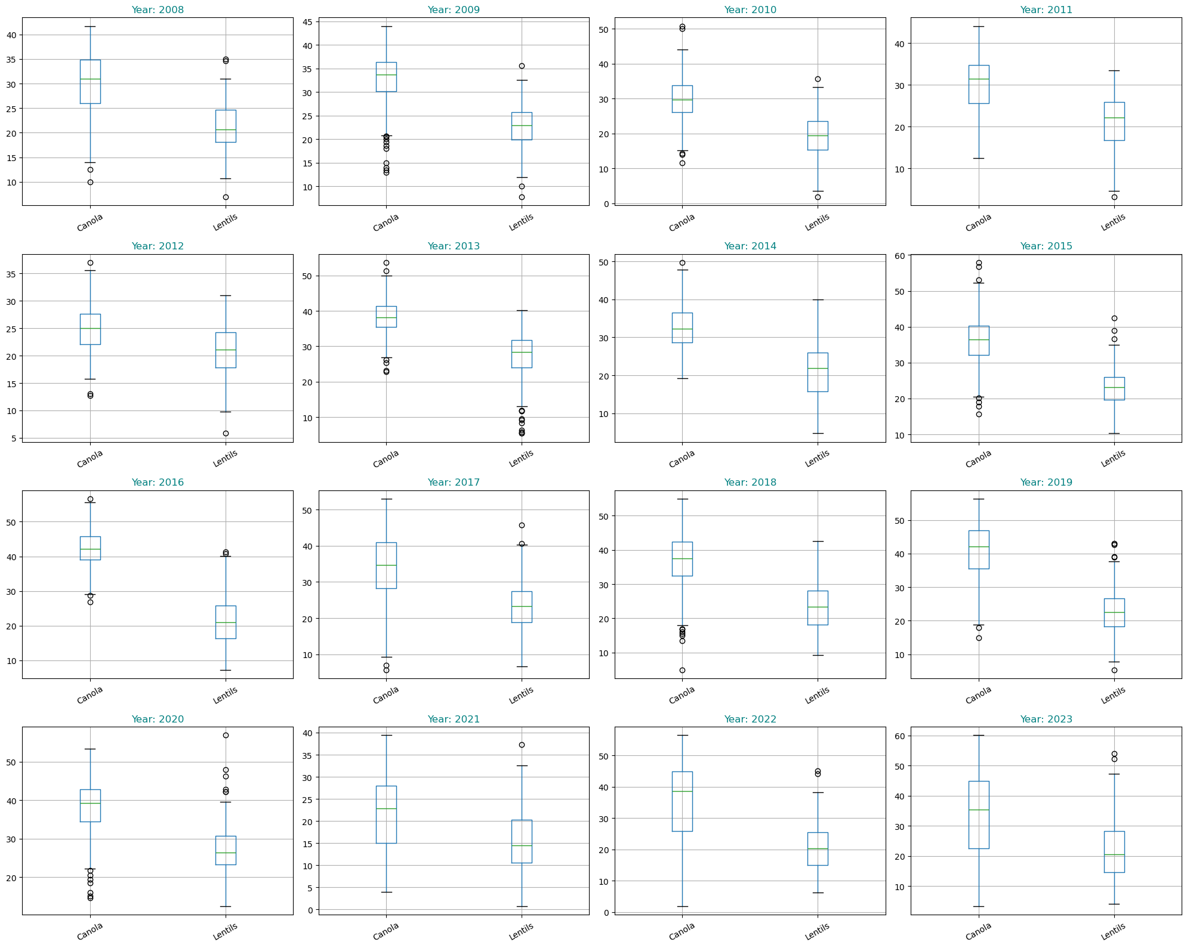
Box Plots of Canola & Lentils from 2008 to 2023
Outliers
Before Treatment

Slide 10
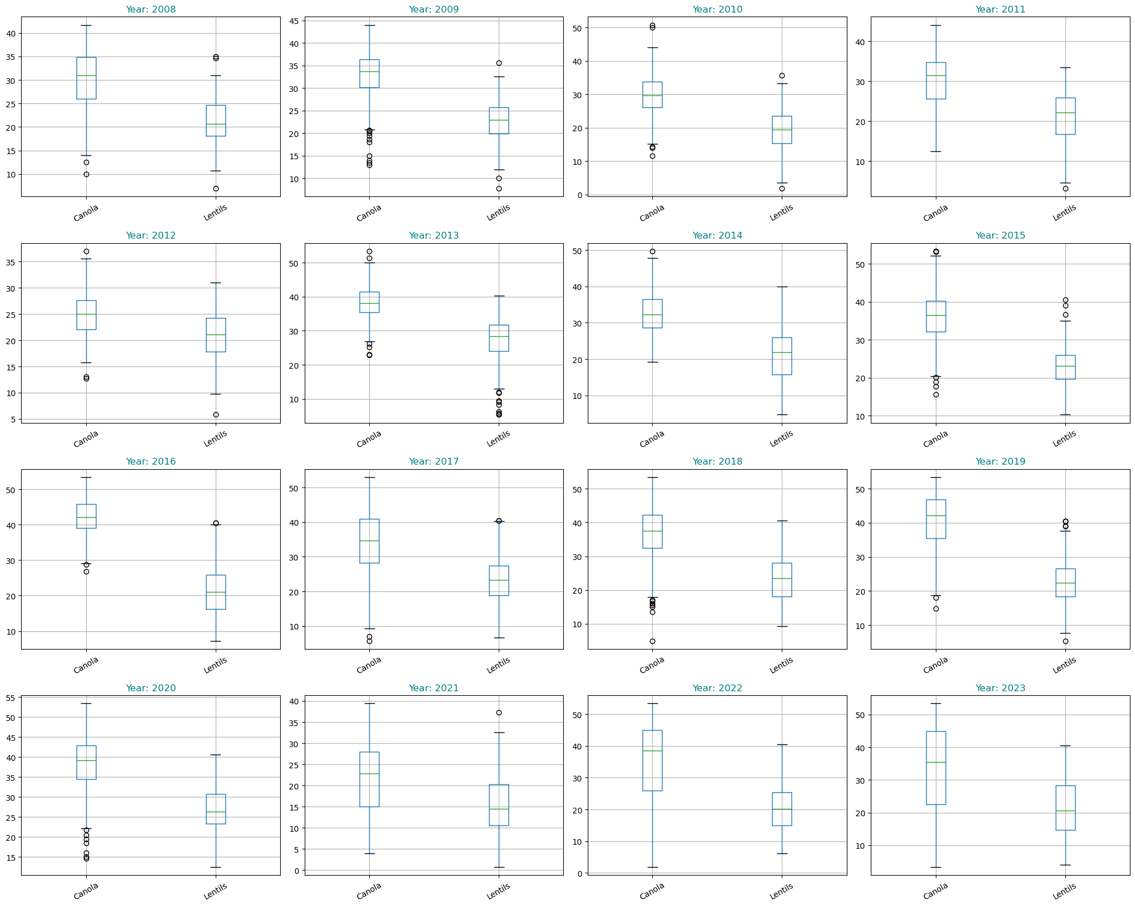
Box Plots of Canola & Lentils from 2008 to 2023
Outliers
After Treatment

Slide 11
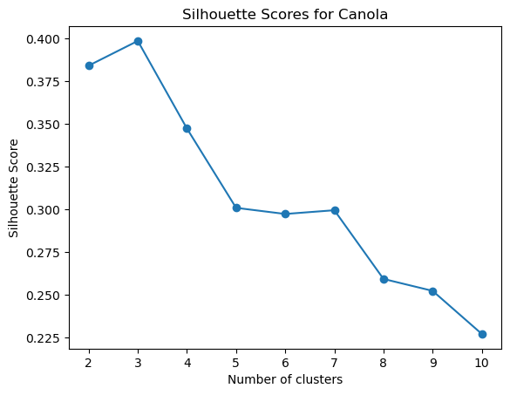
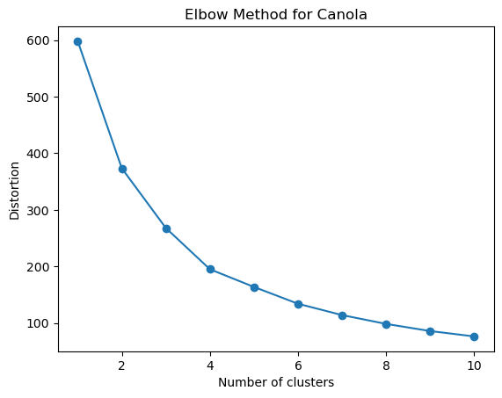
Unsupervised Machine Learning : Spectral Clustering - Canola

Slide 12
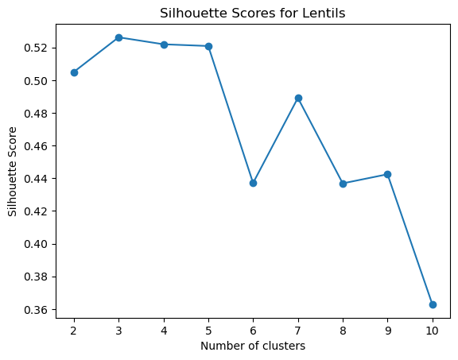
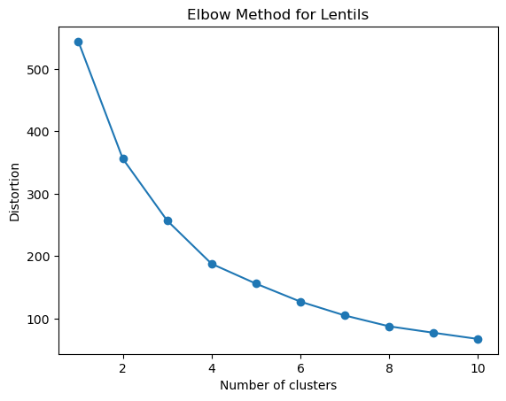
Unsupervised Machine Learning : Spectral Clustering - Lentils

Slide 13
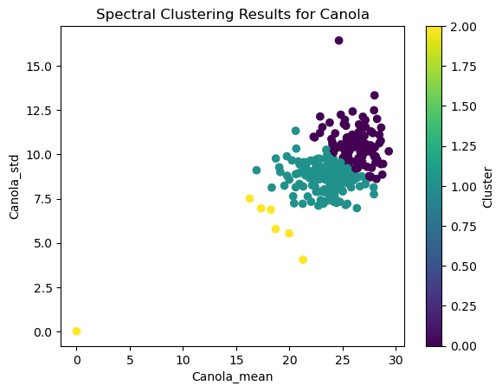
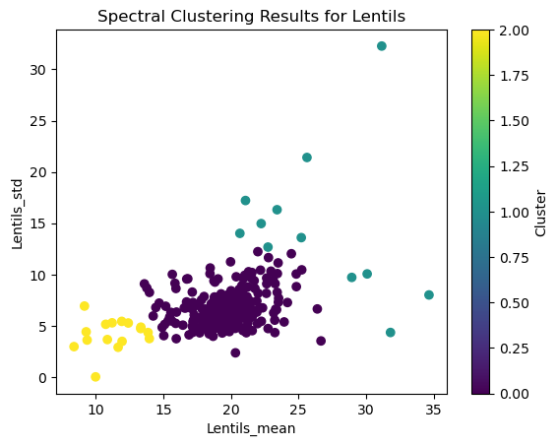
Unsupervised Machine Learning : Spectral Clustering Results

Slide 14
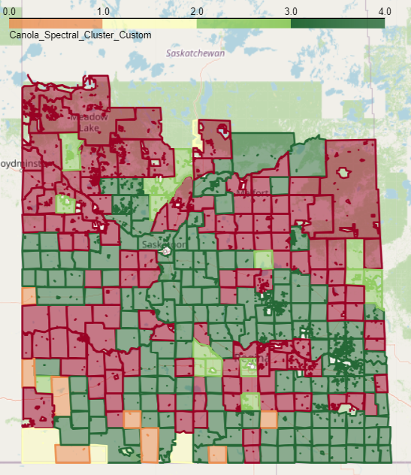
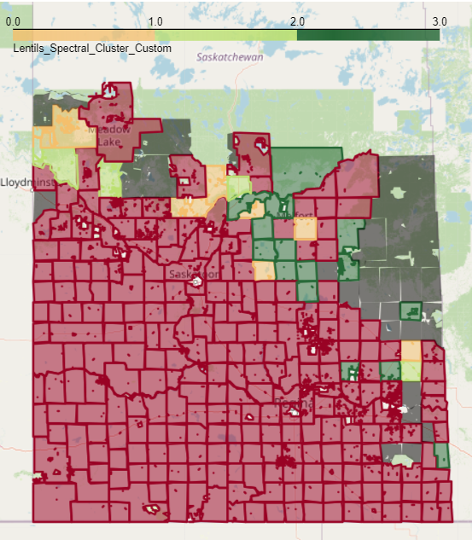
Unsupervised Machine Learning : Custom Spectral Clustering Results
Canola
Cluster Size: 5
Lentils

Slide 15
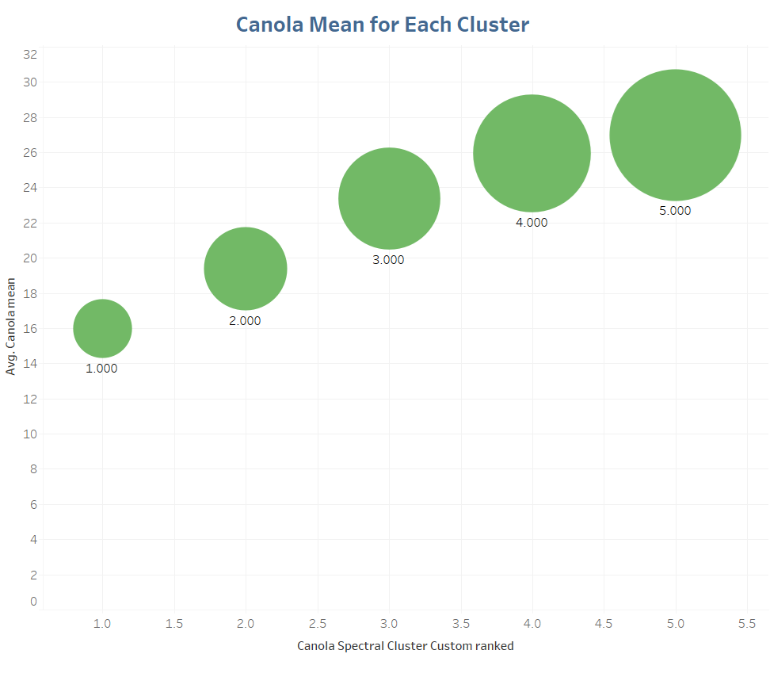
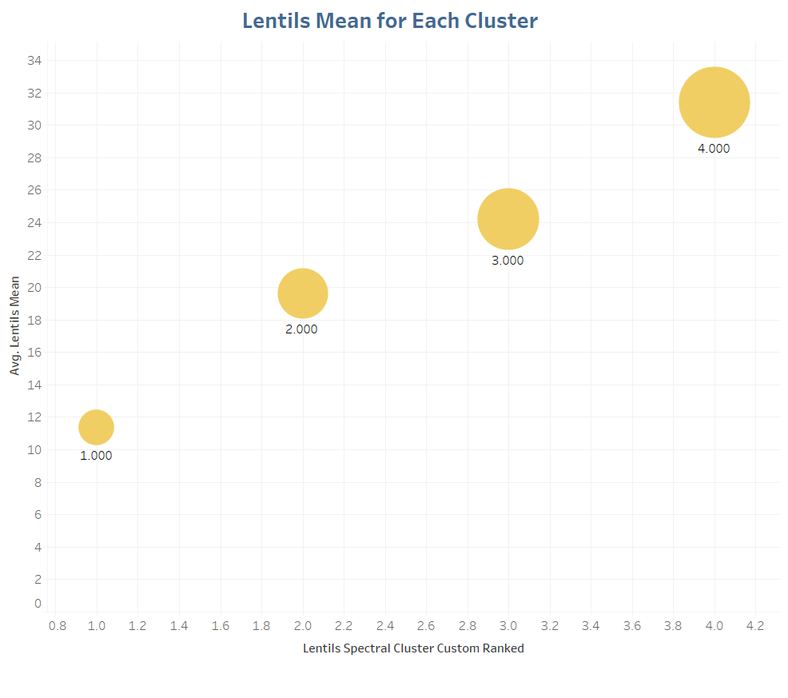
Unsupervised Machine Learning : Mean for Each Cluster
One Cluster for Lentils was NULL

Slide 16
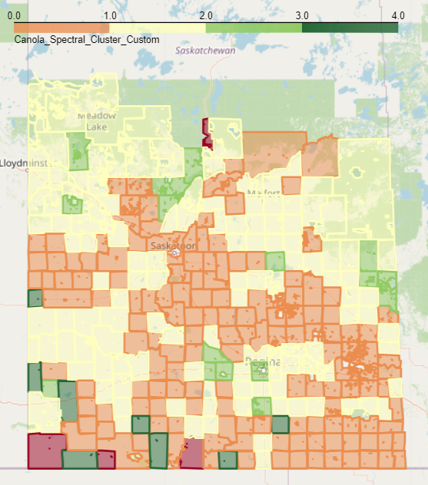
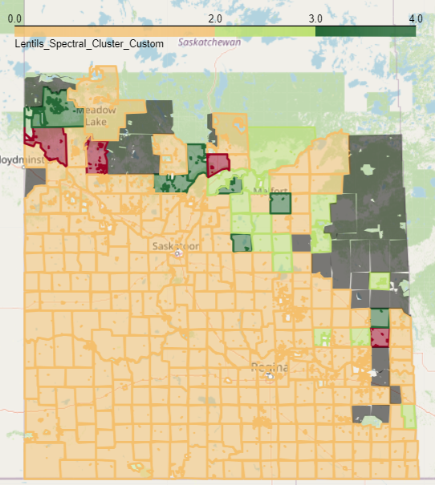
Unsupervised Machine Learning : Custom Spectral Clustering Results
Canola
Cluster Size: 5
Lentils

Slide 17
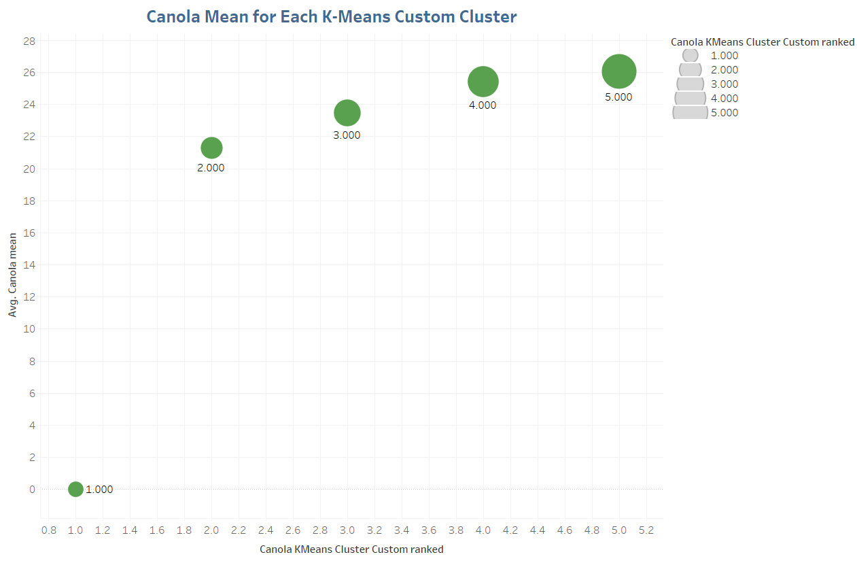
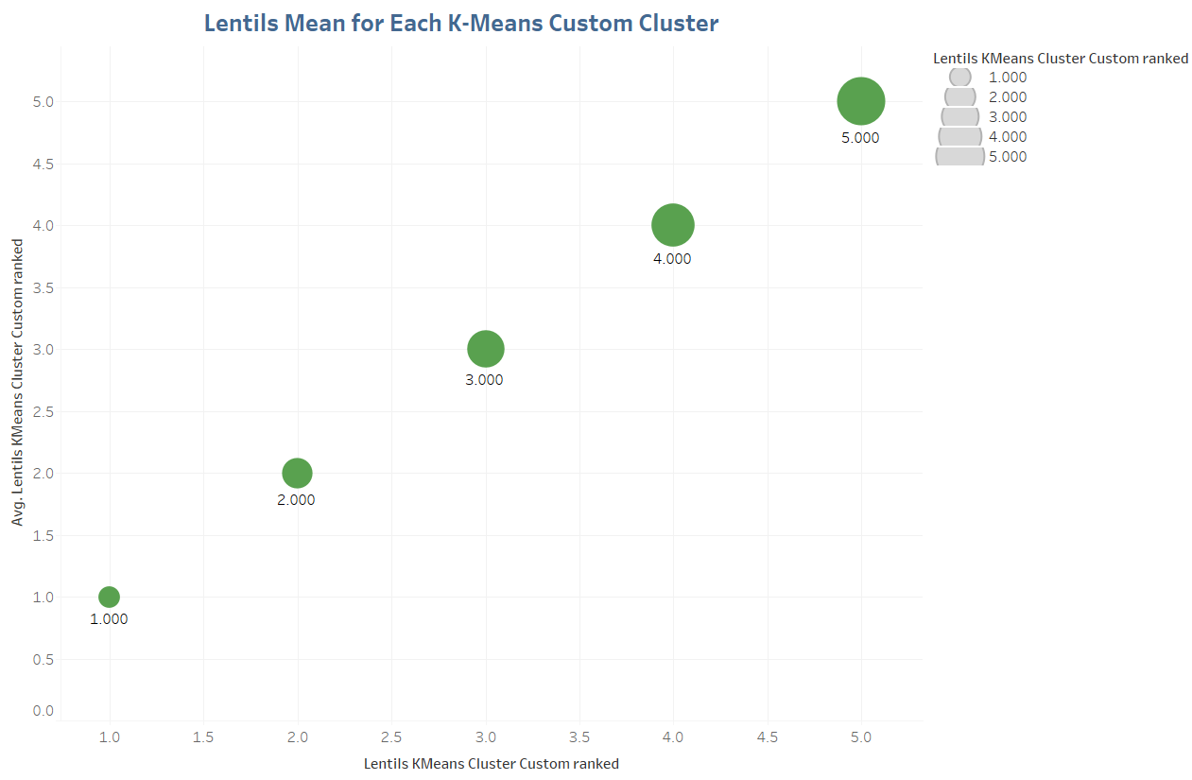
Unsupervised Machine Learning : Mean for Each Cluster
One Cluster for Lentils was NULL

Slide 18
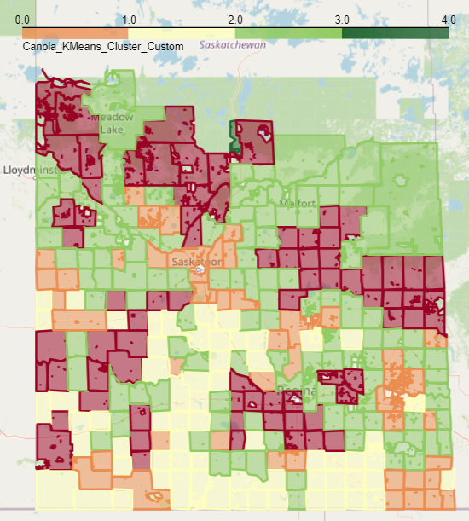
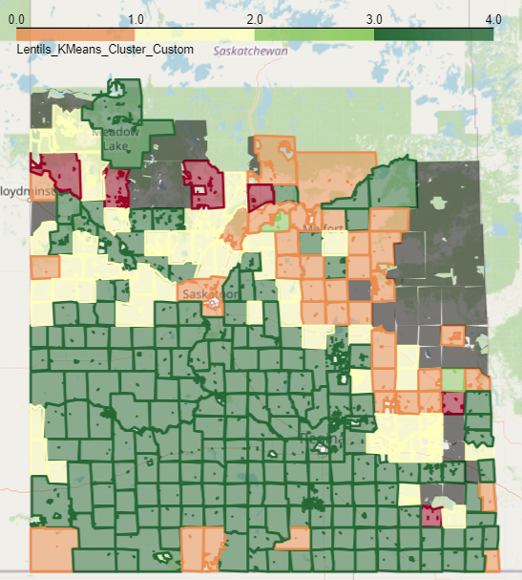
Unsupervised Machine Learning : K-Means Clustering Results
Canola
Cluster Size: 5
Lentils

Slide 19
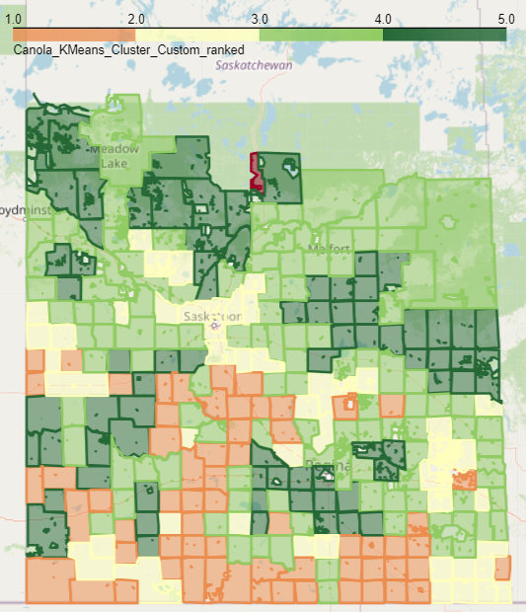
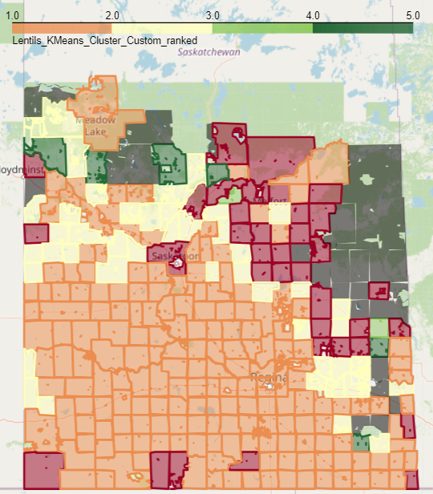
Unsupervised Machine Learning : K-Means Clustering Results
Canola
Cluster Size: 5
Lentils

Slide 20
THANK YOU!!!

